Slide 1
EConfirm (ECC) Employee Compensation Compliance
Payroll Confirmation System
Effort Coordinator Training

Slide 2
Training Agenda (1 of 2)
Managing effort throughout the year
Best Practices
Reports to manage effort
Working with your PI’s
NIH Salary Cap / Late Cost Transfers

Slide 3
Training Agenda (2 of 2)
Accessing EConfirm (ECC)
Managing Effort Coordinators (Primary)
Reading a Project Statement
Project Statement 4-Clicks to Confirmation
Managing PI’s that leave I.U.

Slide 4
Best Practices for Managing Effort (1 of 2)
Payroll is the largest component of most sponsored awards.
Monitor and reconcile accounts monthly.
Appoint personnel to correct accounts.
Review salary charges with the Principal Investigator.
Generate eDocs in a timely manner.

Slide 5
Best Practices for Managing Effort (2 of 2)
Monitor Cost Share commitments
Monitor Employees over Salary Cap
Avoid retroactive payroll
Effort expenses must be posted by the date stated in the final financial report notification. No additional salary charges will be allowed after this deadline.

Slide 6
ORA Compensation Management Reports and Resources
The Office of Research Administration provides several reports and resources to assist departments with the management of compensation on sponsored awards and to support compliance with federal regulation and IU Policy.
The ORA Webpage for Compensation Management Reports and Resources:
Compensation Management Reports:
Provides interactive reports relating to sponsored research at IU
An interactive tool to review award & proposal reports, PI account listing, expenses, expiring grant accounts and final report listing.

Slide 7
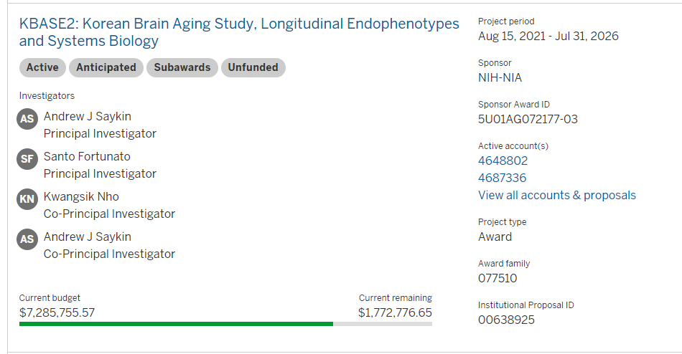
Grants Management Toolkit

Slide 8
Grants Management Toolkit Available Information
In GMT by Investigator(s)you can review:
Enroute Proposals
Pending Proposals
Awards in Progress
Active Awards
Accounts associated with award(s)
Budgets, spending, and amounts remaining

Slide 9
Reports to Manage Effort
Displays summarized institutional Base Salary payroll expenses and percent of effort information by Award and Account Principal Investigator for a given calendar year by Project. Calendar Year Effort mimics project statements in Econfirm
Calendar Year Effort View
Using current job funding, by person and object code, this report provides a projection of salary expenses on an account. These projections are calculated in whole months.
CG Labor Projections
For a single Principal Investigator, the dashboard displays pending proposals, active awards, and advanced accounts. The report also displays payroll detail and account balances for open sponsored program accounts.
Principal Investigator View

Slide 10
Calendar Year Effort View

Slide 11
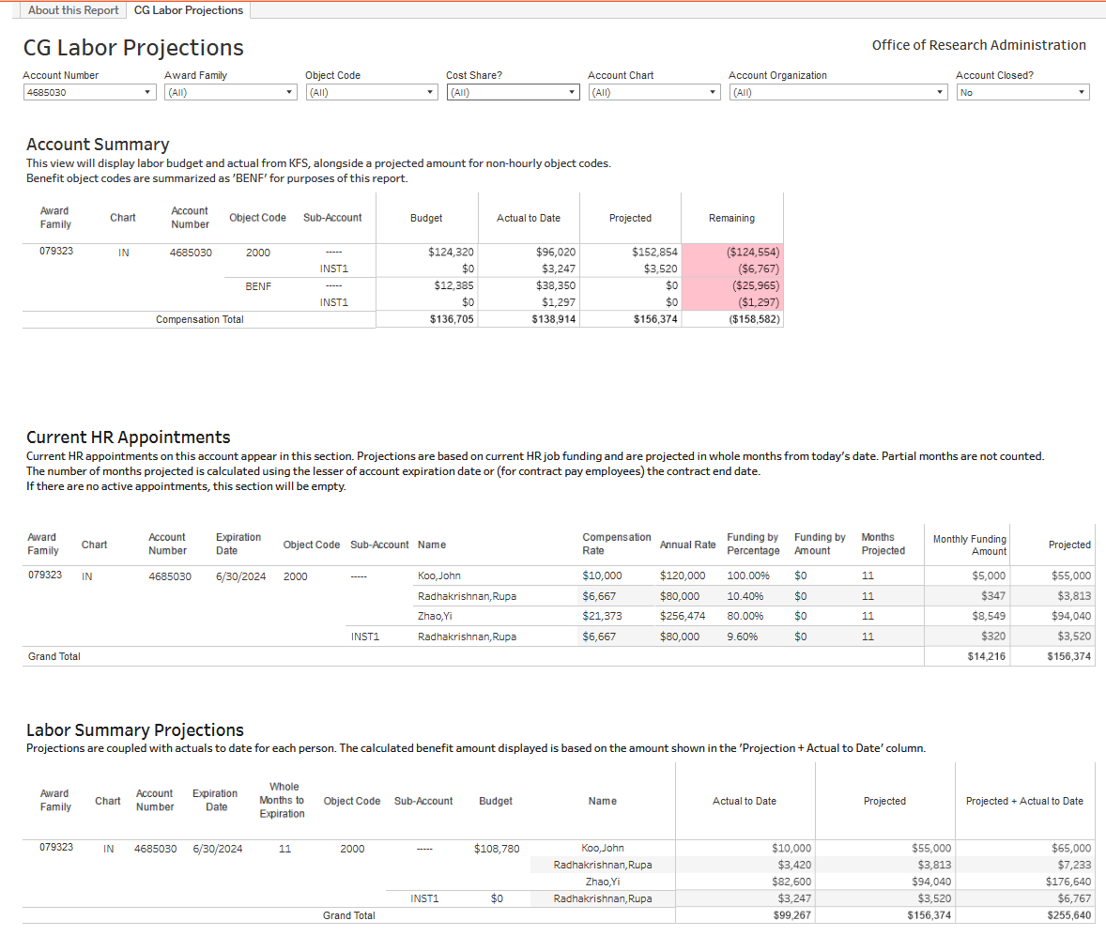
CG Labor Projections Dashboard (1 of 4)

Slide 12
CG Labor Projections Dashboard (2 of 4)

Slide 13
CG Labor Projections Dashboard (3 of 4)

Slide 14
CG Labor Projections Dashboard (4 of 4)

Slide 15
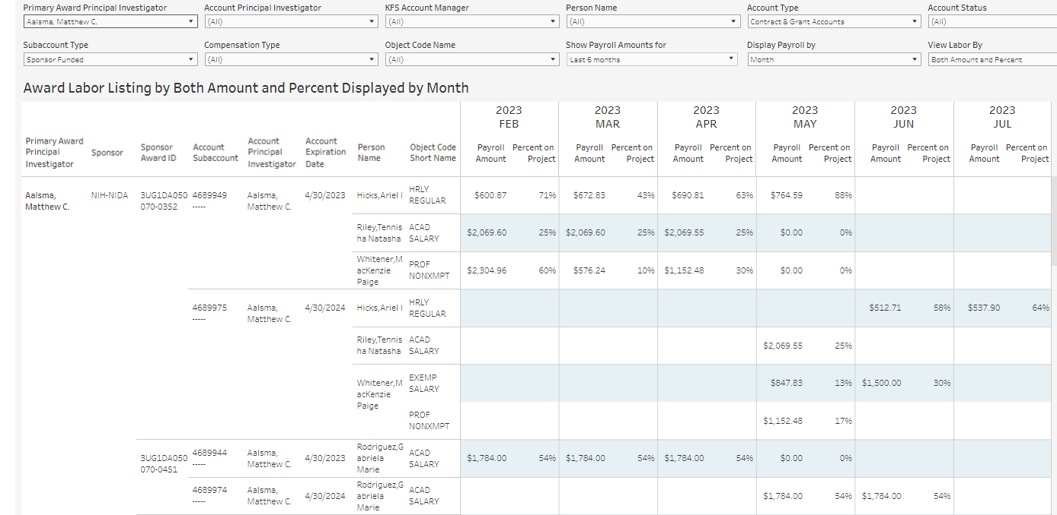
Principal Investigator View Dashboard PI Award Labor Listing

Slide 16
POLL QUESTION
Have you used these ORA Dashboard reports?
Calendar Year Effort View
CG Labor Projections
Principal Investigator View
All of the Above
None of the Above

Slide 17
Questions About These Reports?
Reporting Questions?
Email: ora-inst-rpt-l@indiana.edu

Slide 18
Overview of the Annual Confirmation Process WHY?
Uniform Guidance requires Effort Confirmation and IU policy requires Award Principal Investigators (PI) perform an annual confirmation for the federally sponsored project(s)
The Confirmation process only applies to federally/fed-pass-through sponsored projects
All other project statements for non-federally sponsored awards will automatically change to an auto-approved status in the ECC system and will not appear on the PI’s Work List

Slide 19
Working with your Principal Investigator
Understand
Thoroughly understand unallowable, direct, and facilities and administrative (F&A) costs
Monitor
Monitor awards through monthly review of project salary costs and review with PI approval on a regular basis
Show
Show consistency in charging sponsored award costs
Ensure
Ensure successful project effort confirmation by consistently managing awards

Slide 20
Some Common Project Statement Statuses
Status
Icon
Description
Building
This status indicates that a project statement is not yet ready for confirmation. This occurs during the Period of Performance, when payroll data is being loaded and the project statements are building.
Ready for Confirmation
This status indicates that the project statement is ready to be confirmed. Statements move to this status when the Confirmation Period begins, and the statement requires the PI to confirm the payroll charges for the period.
Revision Requested
During the Confirmation Period, if a PI requests a revision for an employee and clicks the Revise Payroll button the statement moves to this status.
Revision Pending
When new payroll loads to a statement in Revision Requested status and creates a payroll task that will be processed by the Effort Coordinator, that statement moves to this status.
Confirmed
This status indicates that every individual on this project statement has been confirmed.
Auto Approved
This status is for non-federal project statements that are auto approved. The system automatically moves project statements that have no federally sponsored payroll or cost share associated with them into this status when the confirmation period begins.

Slide 21
Managing effort throughout the calendar year
Building
CY2024
Confirm
Confirmed
January through December
Project Statements in Building Status
March 1st Federal and Federal Pass-through Project Statements in Ready for Confirmation Status
April 1st
All Statements must be in Confirmed Status
Review CY2023
MARCH 20th
New Calendar
Year Begins
MARCH
April 1st
January and February
Review CY2023
Project Statements in Building Status
Deadline for salary transfers during confirmation period
March 1st Non-federal project statements auto approved
Salary Transfer Deadline
Review

Slide 22
Late Cost Transfers
Cost transfers for all federal and federal pass-through sponsored awards, including corrections to salary costs, must be initiated and routed to ORA within three months following the month in which the cost was first incurred. Cost transfers affecting a project statement in the confirmation period must be fully routed and approved by March 20th. All Salary Transfers must have justification stated.
Cost Transfer Calendar | Cost Transfer Calendar | Cost Transfer Calendar | Cost Transfer Calendar | Cost Transfer Calendar
Month 1 | Month 2 | Month 3 | Month 4 | Month 5
Original Transaction Date - No ORA Cost Exception Committee review required | No ORA Cost Exception Committee review required | No ORA Cost Exception Committee review required | No ORA Cost Exception Committee review required | Requires ORA Cost Exception Committee review
Cost Transfers on Cost Reimbursable Grants and Contracts SPA-11-003

Slide 23
Salary Cap
Agencies may require a limitation on the amount of salary individuals charge to sponsored awards.
The National Institutes of Health sets a limitation on salary that may be charged to an NIH award on an annual basis.
Other agencies with limitations on salaries will reference the requirement in the award agreement.
Salary charged to these awards over the stated limitation to be recorded as unallowable.
ORA Salary Cap webpage provides information on salary cap requirements, calculation examples, and links to reports to assist with determining and monitoring salary cap on these awards.

Slide 24
EConfirm (ECC) Access
“Four Clicks to Confirmation!”
Access through One.IU.edu. You can search for EConfirm or ECC

Slide 25
Roles in EConfirm (ECC) (1 of 4)
Confirmer (Award PI)
The Award PI for a Project (Award Family)
Can view and confirm their Project Statements
Project Statements are “Ready for Confirmation” March 1st
Confirmers will be required to confirm effort by March 31st – “Four Clicks to Confirmation”
Work with Effort Coordinators to request revisions to Project Statement revisions

Slide 26
Roles in EConfirm (ECC) (2 of 4)
Effort Coordinator
The Effort Coordinator is a department administrator in EConfirm (ECC) “Department” is defined by the KFS Chart-Org in ECC
Fiscal Officers or Delegates (doc types ECD or KFS) for any open grant account in each department will be given this role.
Primary Effort Coordinator
Each Department with CG accounts can have as many Effort Coordinators as they wish, but one person must be designated as the Primary Effort Coordinator for that Department.

Slide 27
Roles in EConfirm (ECC) (3 of 4)
Primary Effort Coordinators | Effort Coordinators | Rights or Actions Available
✔ | ✔ | View Project Statements associated with that Department from their Departmental Dashboard in EConfirm (ECC).
✔ | ✔ | Receive a Task in EConfirm (ECC) when a Project PI requests a revision to an employee’s effort on a Project Statement.
✔ | ✔ | Can select an Effort Coordinator as “Primary.”
✔ |  | Receives an email when the Project PI uses the “Get Help” button on a Project Statement.
✔ |  | Can see Ready for Confirmation Project Statements on the Project Statements tab of their home page
Effort Coordinator

Slide 28
Roles in EConfirm (ECC) (4 of 4)
Determining Primary Effort Coordinators
Updating Fiscal Officers or ECD/KFS doc type delegates in KFS will send updated Effort Coordinator information into EConfirm
The Primary Effort Coordinator must be changed manually within EConfirm (ECC)

Slide 29
Work List

Slide 30
View Effort Coordinators Update the Primary Effort Coordinator Using the Department Dashboard

Slide 31
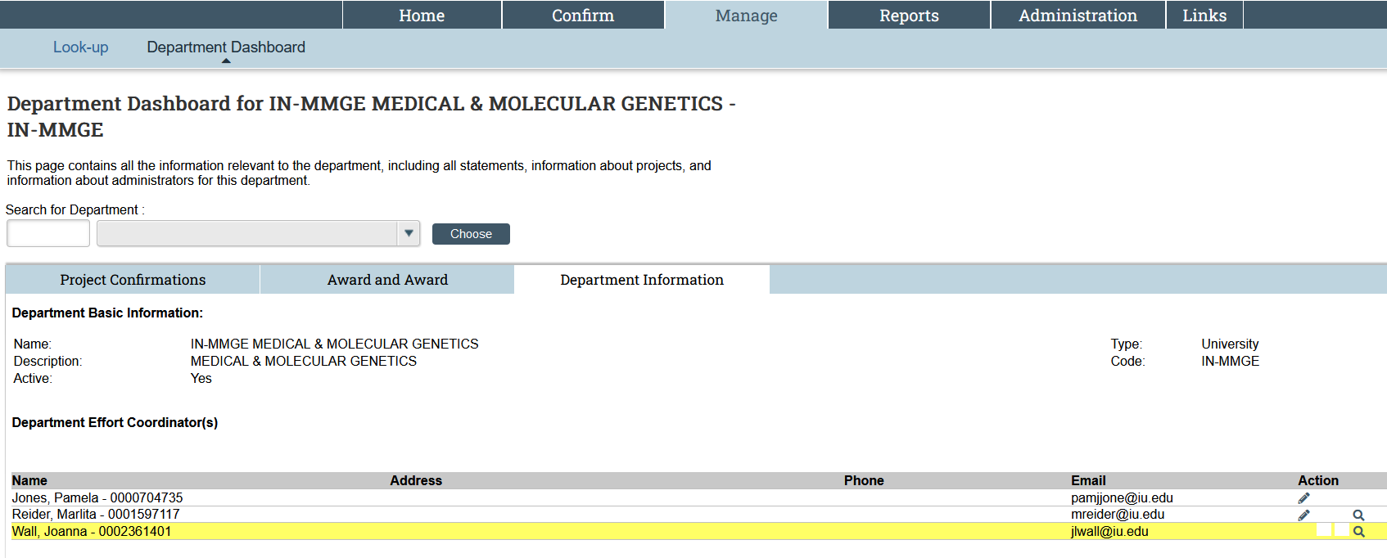
View Effort Coordinators, Update Primary from the Department Dashboard
Select the “Department Information” tab below to see the list of Effort Coordinators. The Primary Effort Coordinator will be highlighted. Click the pencil icon to make someone else the Primary Effort Coordinator.

Slide 32
EConfirm (ECC) Effort Coordinators Dashboard (1 of 2)
Find the effort coordinators and the primary effort coordinator for your department.

Slide 33
EConfirm (ECC) Effort Coordinators Dashboard (2 of 2)
Find the assignments by effort coordinator user name or email.

Slide 34
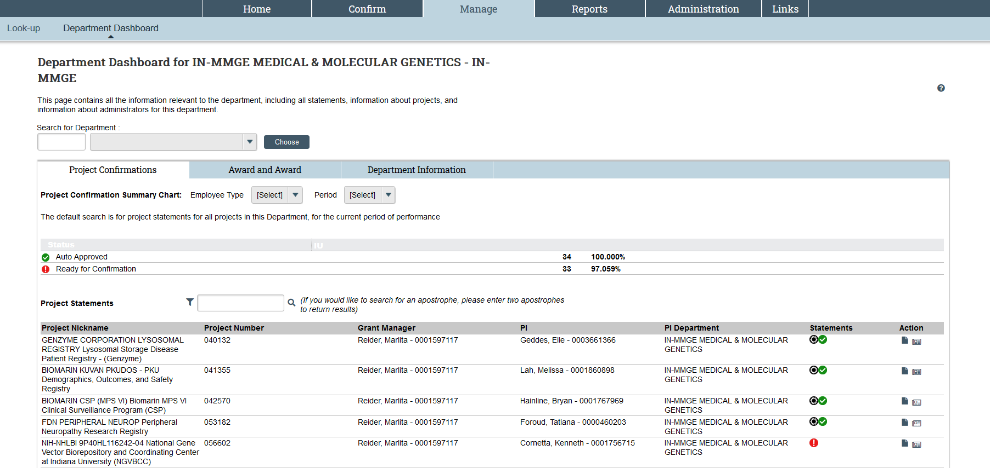
Project Statements by Department (1 of 2)

Slide 35
Project Statements by Department (2 of 2)

Slide 36
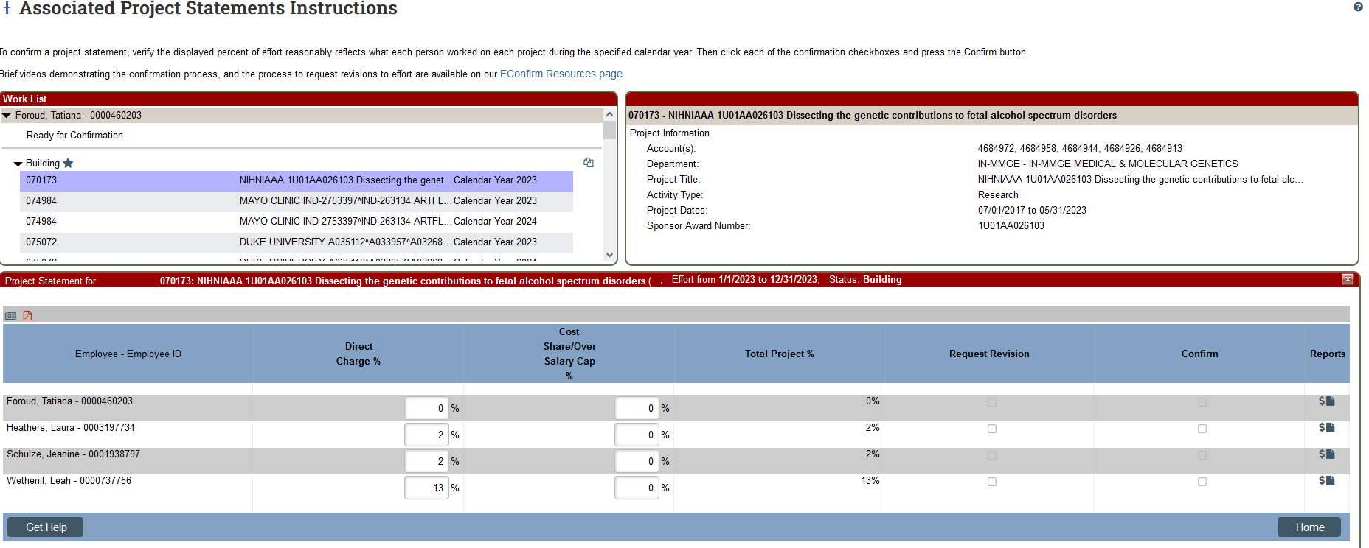
READING A PROJECT STATEMENT

Slide 37
READING A PROJECT STATEMENT The Worklist – (Top Left)

Slide 38
READING A PROJECT STATEMENT Award Summary – (Top Right)

Slide 39
READING A PROJECT STATEMENT Project Statement – (Bottom)

Slide 40
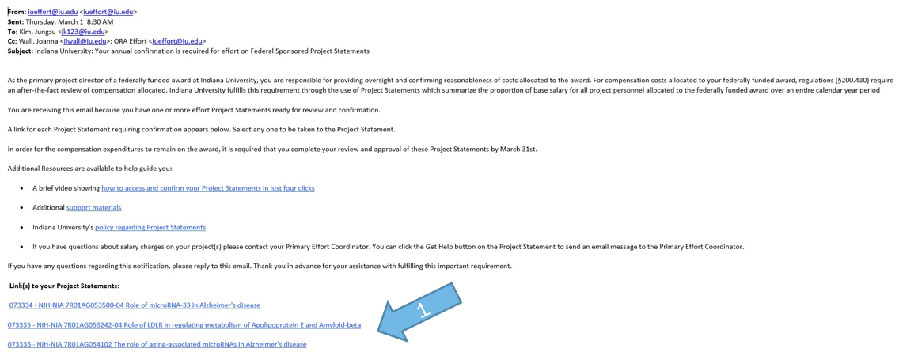
4 Clicks to Confirm (1 of 3)
Click the link in the Confirmer email to confirm the Project Statement in EConfirm (ECC).

Slide 41
4 Clicks to Confirm (2 of 3)
Click the Confirm icon
to select all lines in the Confirm column. You can also select each checkbox
individually.
Click the Confirm button in the shaded ribbon at the bottom of the employee list.

Slide 42
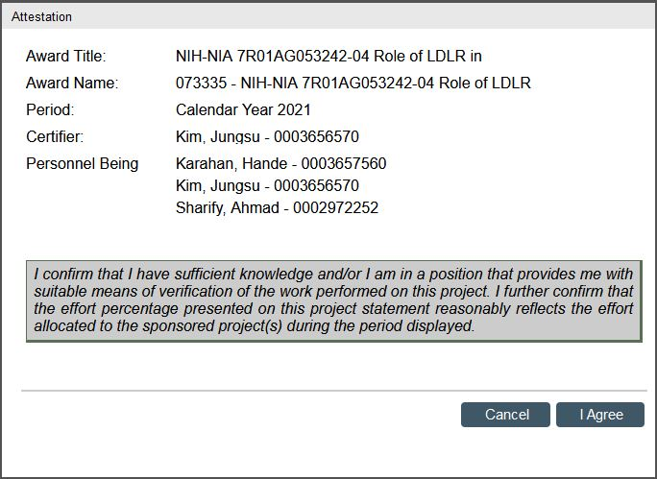
4 Clicks to Confirm (3 of 3)
Review the Attestation Statement which will list all the employees that you are confirming and click I agree to complete the confirmation process.

Slide 43
BEST PRACTICE for revisions – Project Statement Workflow
Project Statement Ready for Confirmation
Confirmer Reviews. Is Effort Accurate?
Project Statement Confirmed
Project Statement Final
YES
Salary transfers affecting a project statement in the confirmation period must be fully routed and approved by March 20th.
NO
Confirmer Consults Effort Coordinator
Effort Coordinator Reviews Project Statement with Confirmer
Effort Coordinator Initiates Salary Transfer in KFS
Salary Transfer Processed
Is an effort change required?
YES
ST is processed – data uploaded to ECC
NO
YES
Additional
change required?
Project Statement Updated
NO

Slide 44
Econfirm initiated revisions - project Statement Workflow
Project Statement Ready for Confirmation
Confirmer Reviews. Is Effort Accurate?
Project Statement Confirmed
Project Statement Final
YES
NO
Salary transfers affecting a project statement in the confirmation period must be fully routed and approved by March 20th.
PI Requests Revision
Effort Coordinator Approves - Project Statement “Revision Pending” Status
Effort Coordinator Initiates Salary Transfer in KFS
Salary Transfer Processed
Effort Coordinator Receives Notification Project Statement “Revision Requested” Status
Is an effort change required?
YES
ST is processed – data uploaded to ECC
NO
Effort Coordinator Disapproves
Effort Coordinator clicks “Post and Maintain”
YES
Effort Coordinator clicks “Post”
Additional
change required?
Project Statement Updated
NO

Slide 45
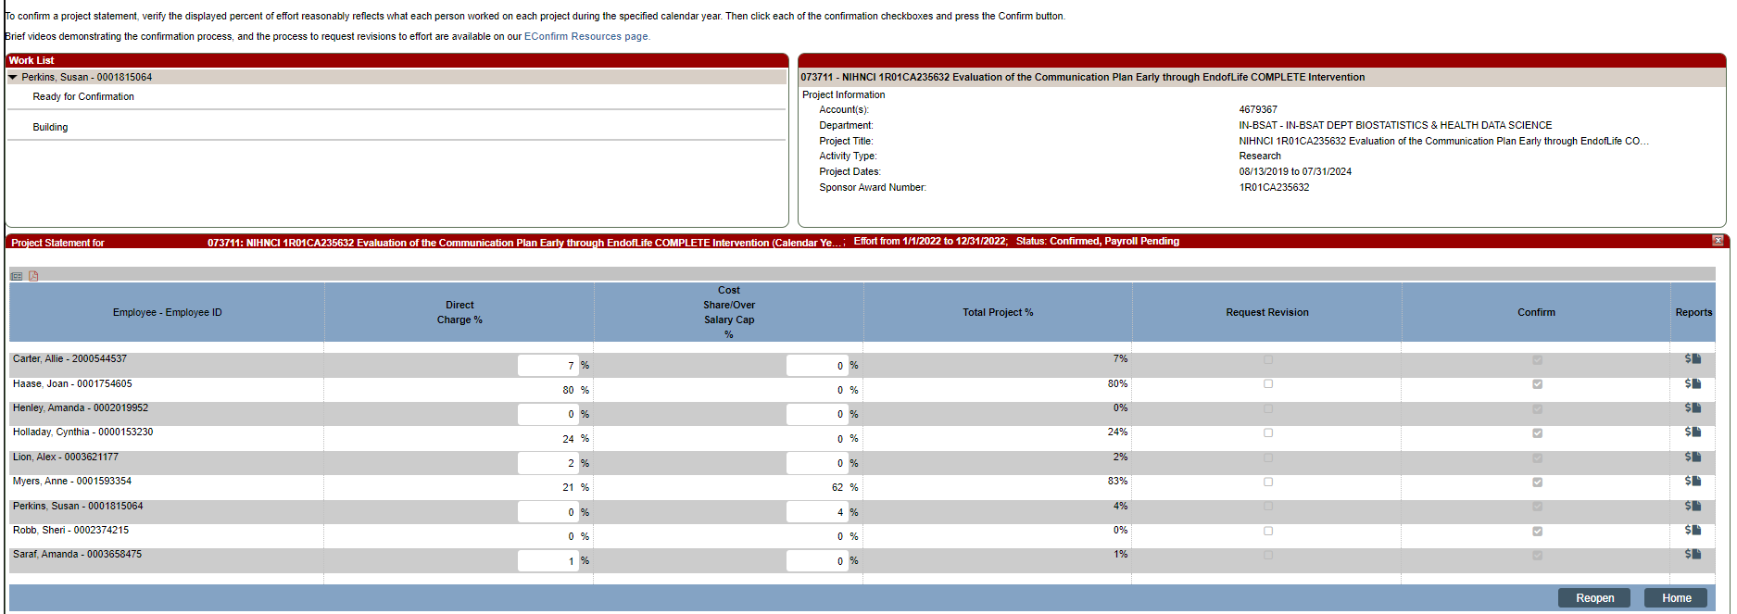
Project Statement Revision Requested Task

Slide 46
Project Statement Revision Pending Task

Slide 47
Annual Timeline Review Period
January
Informal review period for Calendar Year 2023 Project Statements begins.
Calendar Year 2024 (Jan 1st – Dec 31st) Project Statements start to build.
“Office Hours”: Starting Thursdays in January
1-hour Zoom office hours will be available for anyone who has questions or wishes to get one-on-one assistance

Slide 48
Annual Timeline Confirmation
March
Confirmation period for Calendar Year 2023, March 1st – March 31st
Email notification to PIs March 1st of confirmation period start.
Cost transfers affecting a project statement in the confirmation period must be fully routed and approved by March 20th.
April 1st, All statements must be confirmed.

Slide 49
Email Reminders to PI’s (Project Confirmers)
EConfirm will send out reminders to the Project Confirmers - The Primary Effort Coordinators are copied on these emails
March 1, 2024
March 15, 2024
March 25, 2024
March 28, 2024
March 29, 2024

Slide 50
Project Statement Confirmation
What do you need to do now?
Verify your department has the correct Primary Effort Coordinator
Verify your Effort Coordinators have been assigned
Check your Award PI (Confirmer) and be familiar with the Award Family!!!
Monitor Effort on a Monthly Basis
Monitor Salary Cap
Avoid Late Cost Transfers

Slide 51
Training Timeline (1 of 2)
Effort Coordinator Training January – March 2024
Monthly training offerings begin, offering zoom sessions. Recorded trainings will be made available
Date | Time | Link
Monday, January 8, 2024 | 2:00 PM | https://iu.zoom.us/j/84528126936
Tuesday, January 23, 2024 | 2:00 PM | https://iu.zoom.us/j/84528126936
Monday, February 5, 2024 | 2:00 PM | https://iu.zoom.us/j/81133496708
Tuesday, February 20, 2024 | 10:00 AM | https://iu.zoom.us/j/81303190808
Tuesday, March 5, 2024 | 2:00 PM | https://iu.zoom.us/j/82201643060

Slide 52
Training Timeline (2 of 2)
PI Confirmer Training January – March 2024
Monthly training offerings begin, offering zoom sessions. Recorded training will be made available
Date | Time | Link
Tuesday, January 9, 2024 | 10:00 AM | https://iu.zoom.us/j/84100490069
Monday, January 22, 2024 | 2:00 PM | https://iu.zoom.us/j/81370853893
Wednesday, February 7, 2024 | 2:00 PM | https://iu.zoom.us/j/81408677020
Monday, February 19, 2024 | 9:00 AM | https://iu.zoom.us/j/82919551766
Thursday, March 7, 2024 | 2:00 PM | https://iu.zoom.us/j/84767742744

Slide 53
Office Hours
Date | Time | Link
Wednesday, January 10, 2024 | 10:00 AM | https://iu.zoom.us/j/84414329686
Tuesday, January 16, 2024 | 2:00 PM | https://iu.zoom.us/j/87396214066
Wednesday, January 24, 2024 | 2:00 PM | https://iu.zoom.us/j/83711243848
Tuesday, January 30, 2024 | 2:00 PM | https://iu.zoom.us/j/85999599879
Tuesday, February 6, 2024 | 3:00 PM | https://iu.zoom.us/j/82577465300
Wednesday, February 14, 2024 | 10:00 AM | https://iu.zoom.us/j/82096757450
Wednesday, February 21, 2024 | 10:00 AM | https://iu.zoom.us/j/89794515118
Tuesday, February 27, 2024 | 10:00 AM | https://iu.zoom.us/j/89753384329
Wednesday, March 6, 2024 | 10:00 AM | https://iu.zoom.us/j/82809969607
Tuesday, March 12, 2024 | 2:00 PM | https://iu.zoom.us/j/87805638587
Thursday, March 21, 2024 | 10:00 AM | https://iu.zoom.us/j/85041918333
Wednesday, March 27, 2024 | 10:00 AM | https://iu.zoom.us/j/84137077132

Slide 54
When Award PI (Confirmers) Leave IU
Please work with your Effort Coordinator to provide the following information to ORA:
The last day of employment at IU
The awards that will remain at IU
The awards that will leave IU
Termination dates for each of the awards
Confirmation that all salary, including cost share has been recorded on each of the awards
Reach out to iueffort@iu.edu with any questions. We are here to help!

Slide 55
Guides and Videos
These guides and videos will soon appear on the ORA website
Confirmer (PI) Guide
Effort Coordinator Guide
Four Clicks to Confirmation Video
Confirm Your Project Statement Video
ORA Web Page

Slide 56
Have Questions or Need Assistance?
Please contact iueffort@iu.edu
Or
Tim Burris thburris@iu.edu (812) 855-0185
Rayna Amerine ramerine@iu.edu (812) 855-1516

